Slide 1
UPDATE: Goals & strategy
May 27, 2015

Slide 2

Who is One Mind?
One Mind is dedicated
to benefiting all affected by brain
illness and injury through fostering fundamental changes in the research eco-system – including promoting open science principles – that will radically accelerate the development and implementation of improved diagnostics, treatments and cures – while eliminating the stigma that comes with
mental illness.
Proprietary & Confidential
2

Slide 3
One of Many Problems
“As we had discussed, I'm following up with regard to the issue of incentives to share data in academia. Having spent time in academia, I think the challenges come from the way that academic research is funded, and what's required to build a successful academic career. Academics need to bring in external funding to cover a significant proportion of their time – when I was at a REPUTABLE U.S. University, I was responsible for covering 100% of my salary, plus the salary of anyone I hired to work on my projects. The majority of that funding comes through NIH, and to be competitive for large NIH grants, you need a very strong track record of publications in top-tier journals. To successfully publish in those journals, you need to have something unique. As a basic matter of survival, then, it's nearly impossible to share your data – since that would mean that someone else can (and will) publish based on your data, and your unique contribution is no longer yours. At the same time, not sharing data can pose the types of challenges to the advancement of science that we had discussed.”
- Anonymous Colleague
Proprietary & Confidential
3

Slide 4
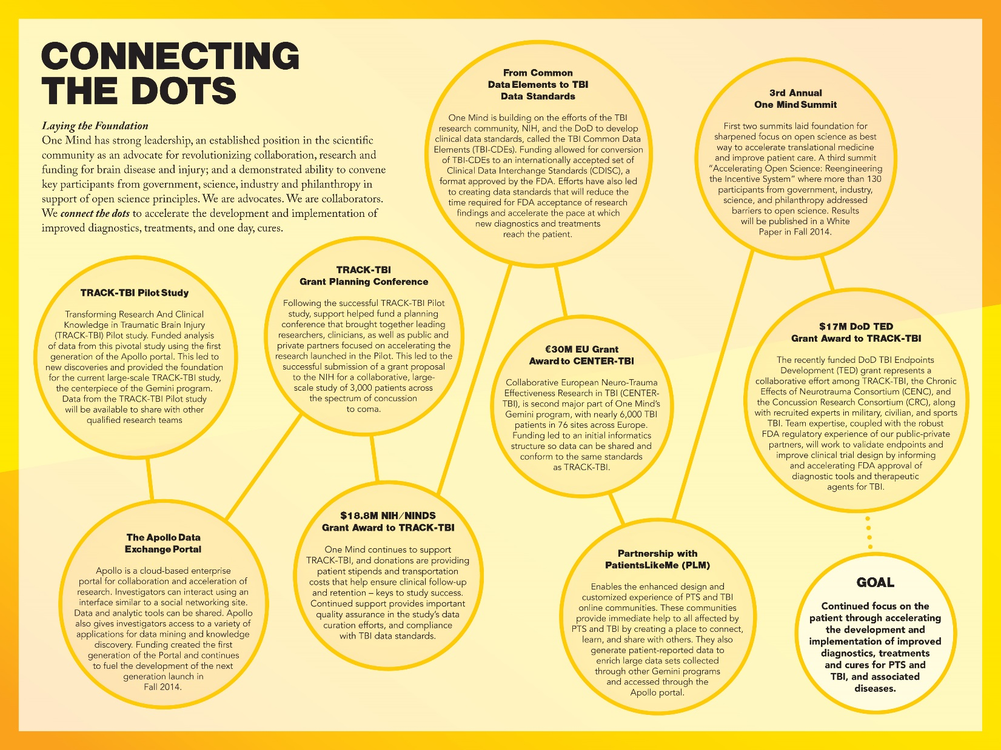
Proprietary & Confidential
4

Slide 5
Silos within Silos
Traumatic Brain Injury (TBI)
Post-Traumatic Stress (PTS)
Parkinson’s Disease
ALS
Study 6
Study 5
Study 6
Study 7
Study 5
Study 4
Study 4
Study 6
Study 4
Study 5
Study 3
Study 4
Study 4
Study 3
Study 2
Study 3
Study 3
Study 2
Study 1
Study 1
Study 2
Study 1
Study 2
Study 1
Proprietary & Confidential
5

Slide 6
One Mind’s
Open Science Principles
What is Open Science?
Open Science is a global movement to make scientific research,
results and data available, and accessible to everyone.
Why Does ONE MIND Support Open Science?
believe “open notebook research” and more access to scientific data
We
will:
•
•
•
•
foster collaboration and innovation;
accelerate replication and validation of results;
allow increased data integration and power for statistical analysis;
and, most importantly, accelerate the translation of basic research to clinical use so patients receive improved diagnostics and treatments.
Proprietary & Confidential
6

Slide 7
One Mind’s
Open Science Principles
To support Open Science for brain disease and injury, ONE MIND urges the adoption of the following Principles by the international research community:
Consistent with protecting patient privacy, informed consents for collection of medical data obtained from patients should permit use of their de-identified (anonymous) data for research related to a broad range of conditions.
Clinical data collected should use widely accepted common data elements and conform to the highest possible standards so it can be used by the widest possible array of users, whether academic, medical, clinical, or commercial.
Researchers should make data available to the research community as soon as possible after study completion, with the goal of opening data access within 6 months whenever possible.
Access to data should, subject to relevant data use agreements, be made available to external researchers during the course of a study.
Data generators should receive proper attribution & credit from those who use their data.
Publication of findings that may affect patient care should not be unreasonably delayed.
Intellectual property should not stand in the way of research, but be used to incentivize material participation.
Proprietary & Confidential
7

Slide 8
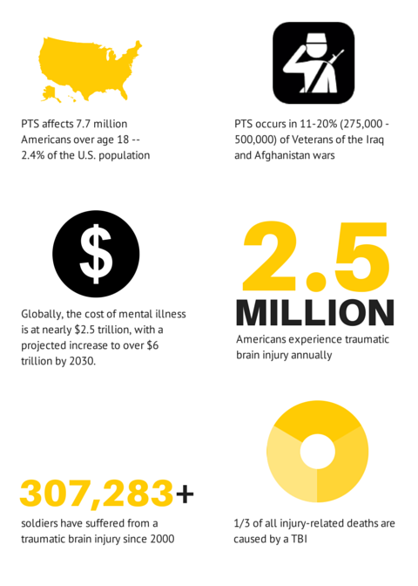
Proprietary & Confidential
8

Slide 9

Prospective Longitudinal Observational Study
  3,000 subjects – including Controls
  Across the spectrum from concussion to coma
Goals
Improve TBI diagnosis and classification/taxonomy
Improve TBI outcome assessment
Identify the health and economic impact of Mild TBI patient disposition
Create a “Information Commons” to promote collaboration and
acceleration of TBI research
Proprietary & Confidential
9

Slide 10
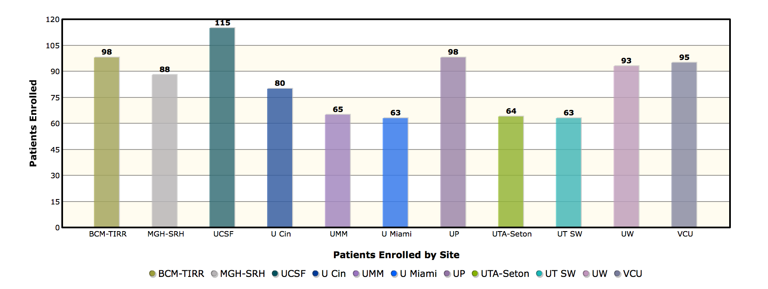
Progress to Date
922 Subjects in 15 months
Proprietary & Confidential
10

Slide 11
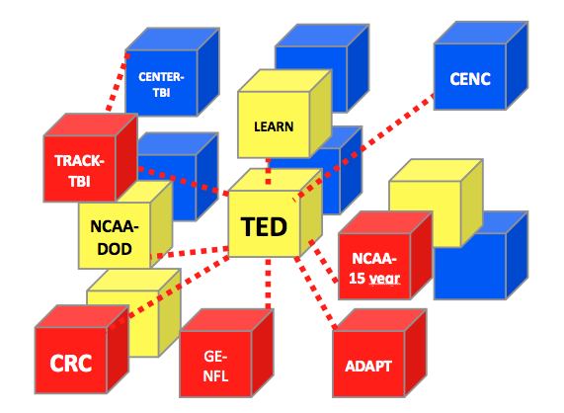
TBI Endpoints Development Grant – TED
Proprietary & Confidential
11

Slide 12
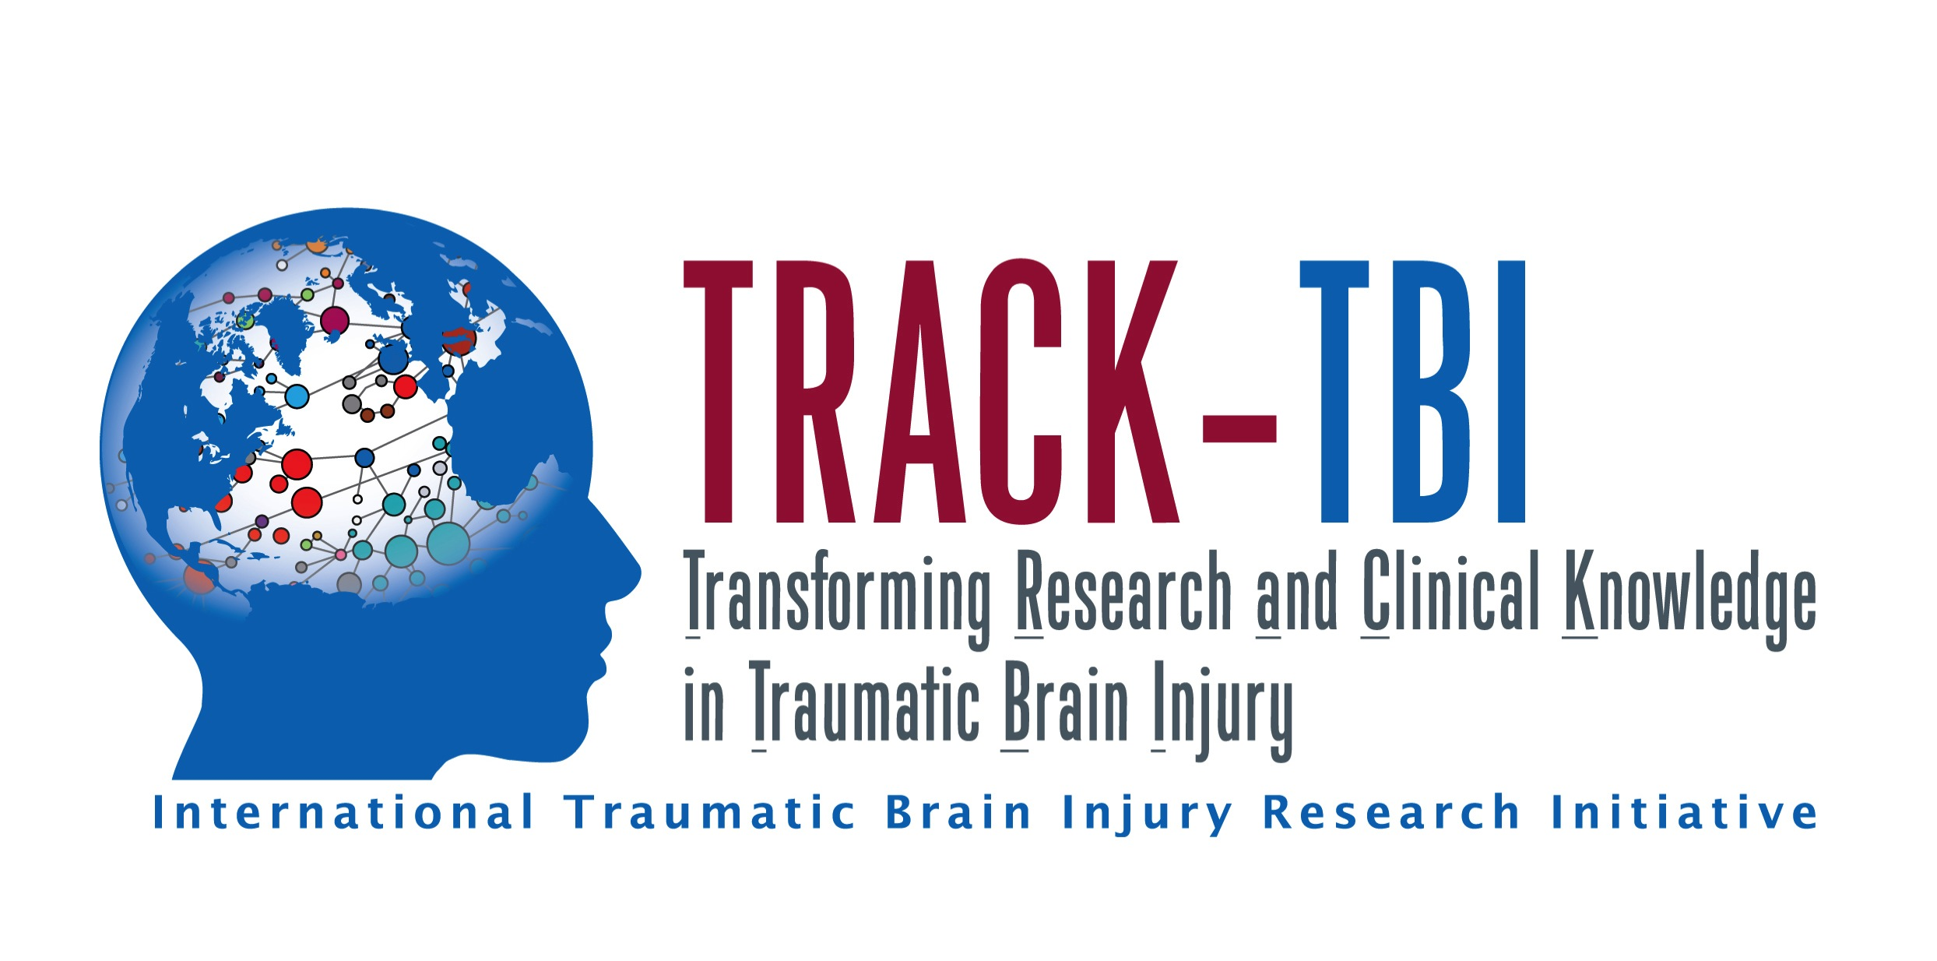
Current Research/Grant Cycle
Start-up
Patient Enrollment
Analysis
Late 2013
2014
2017
2018
>900 of 3000 subjects
Nearly 600 MRI scans
Over 1500 biospecimens
Proprietary & Confidential
12

Slide 13
Current Research/Grant Cycle
Start-up
Patient Enrollment
Analysis
Late 2013
2014
2017
2018
Papers
Grants
1 – 2 Years
Proprietary & Confidential
13

Slide 14
Current Research/Grant Cycle
Start-up
Patient Enrollment
Analysis
Late 2013
2014
2017
2018
Analysis
2015
Early Deliverables
Proprietary & Confidential
14

Slide 15

Pathway from Idea to Regulatory Approval
Idea/Discovery Research
Large-Scale Validation
Regulatory Approval
922
Subjects
Biomarker RFIs
CPIM
CDISC
Acceleration through Collaboration
Proprietary & Confidential
15

Slide 16
Current Research/Grant Cycle
Start-up
Patient Enrollment
Late 2013
2014
2017
Analysis
2015
Patient Enrollment
2018
Proprietary & Confidential
16

Slide 17



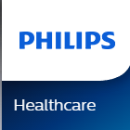

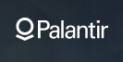







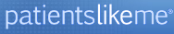











Public-Private Partnership
Proprietary & Confidential
17

Slide 18
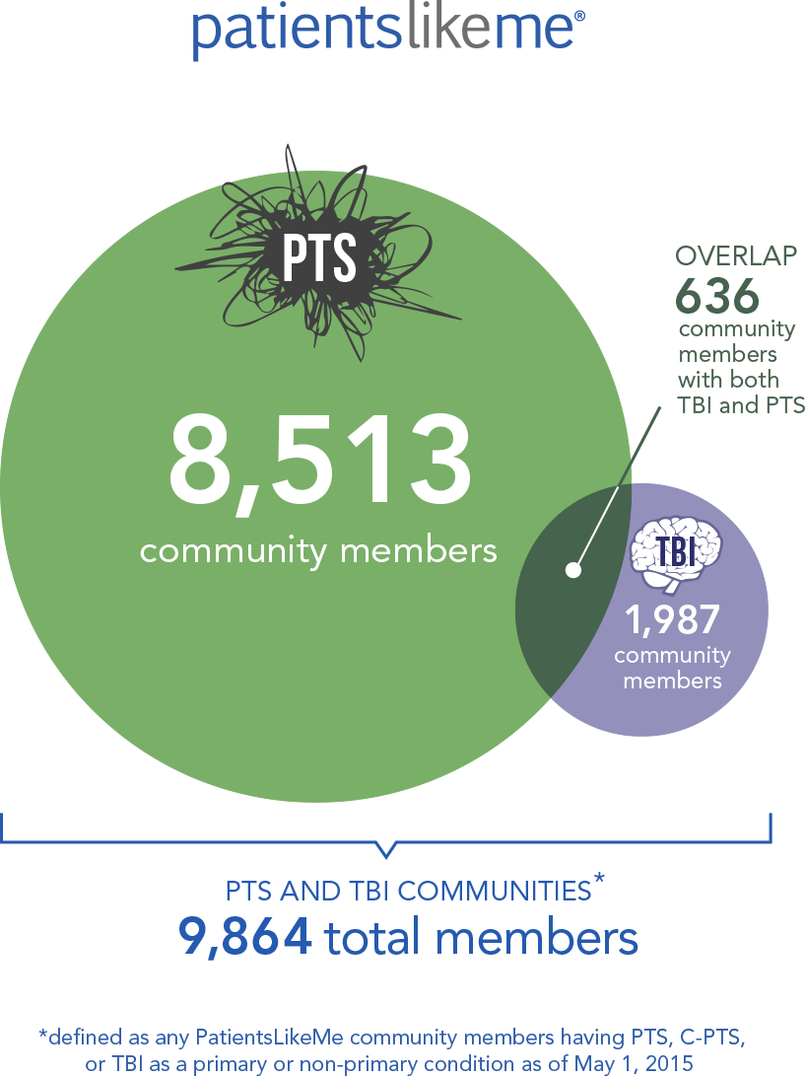
PTS and TBI Online Communities
Proprietary & Confidential
18

Slide 19
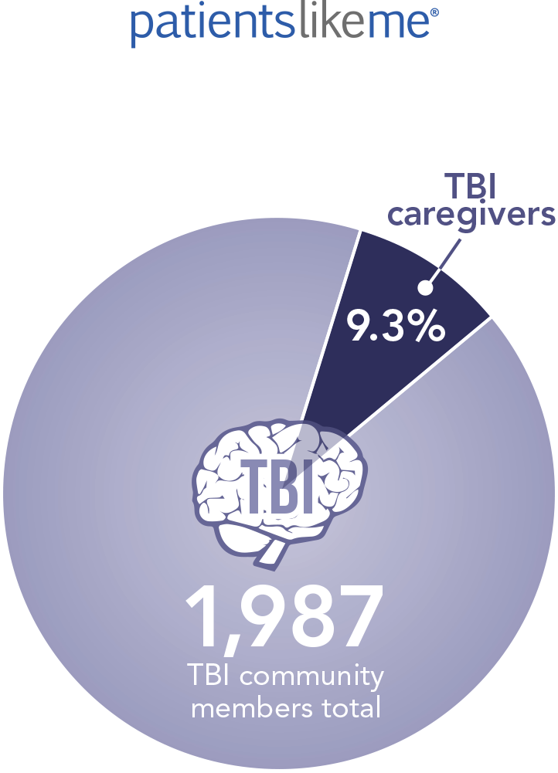
TBI Community Caregivers
Proprietary & Confidential
19

Slide 20
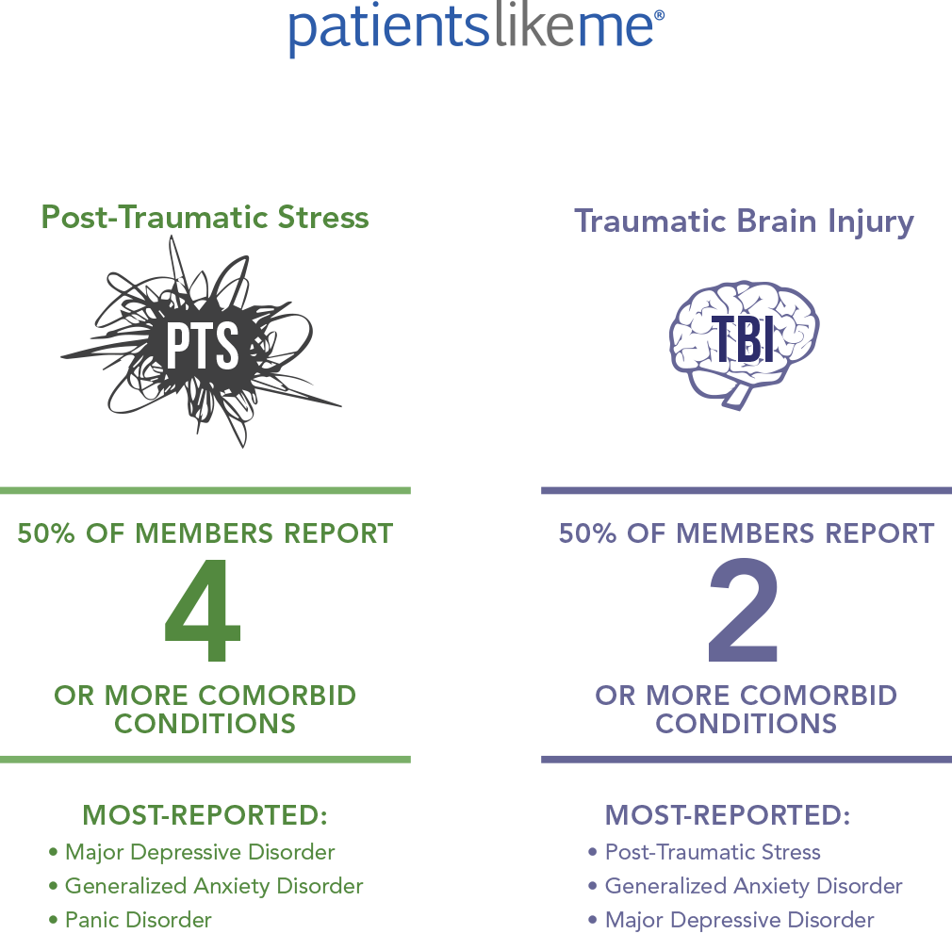
PTS and TBI Community
Comorbidities
Proprietary & Confidential
20

Slide 21
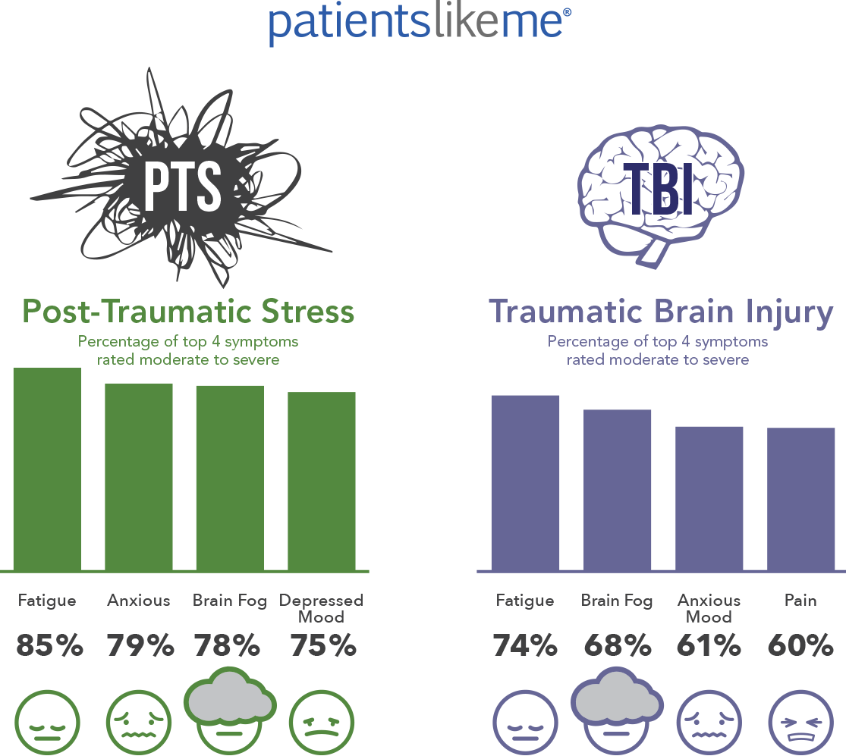
PTS and TBI Communities
Top Symptoms
Proprietary & Confidential
21

Slide 22
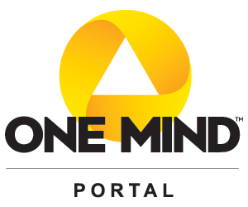

Portal Goals
Generate and Share Data
  Use a portal system to access global coherent datasets
  Build an inter-operable infrastructure for collation, curation and hosting of datasets for the R&D community
  Common standards and methods for data collection
Generate and Share Tools
  Provide a sandbox for next-generation data analytics, processing, and visualization tools through community social networking
Create Insight
  Tap Global Expertise (multi-disciplinary & global) – crowd-sourced collaborative solutions
An Open Science Framework
to Promote Collaboration and Cooperation
Proprietary & Confidential
22

Slide 23

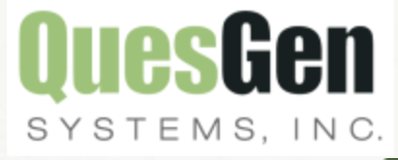
Portal Elements
Collaboration Space (Data + Analytics + People + Scientific Projects)
Project Based Collaboration*
Integrated Analytics
Social Networking
Data ETL &
Curation
Digital Marketplace
Data ETL &
Curation
Data Acquisition
Research
Community
Data
Standards
Proprietary & Confidential
23

Slide 24
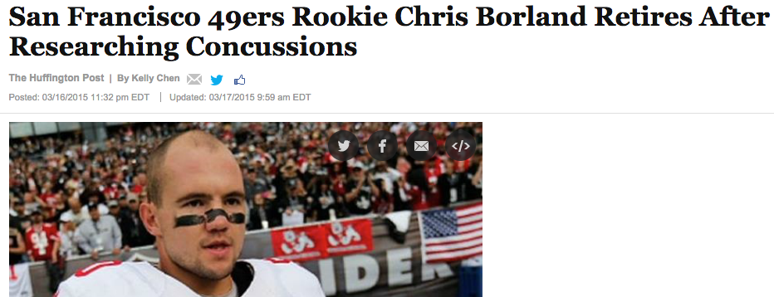
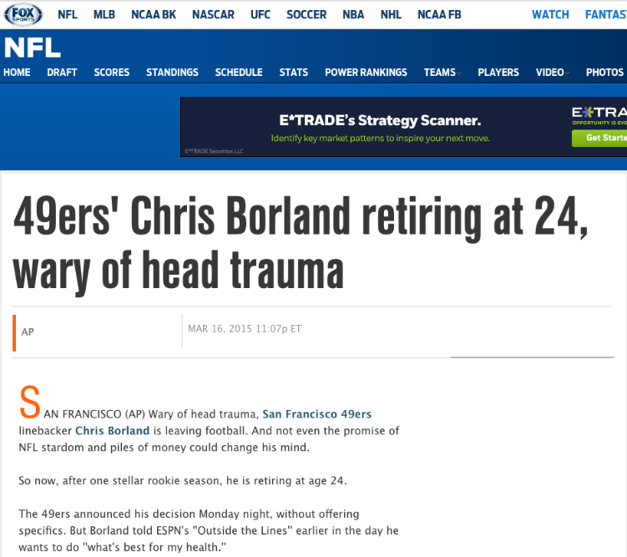
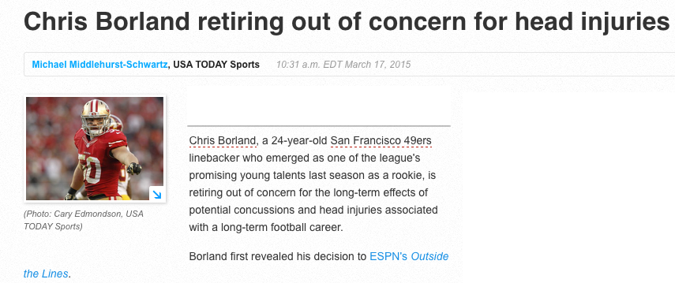
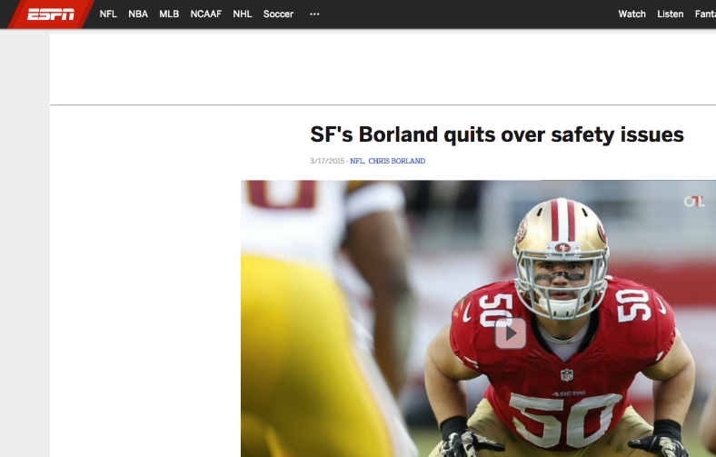
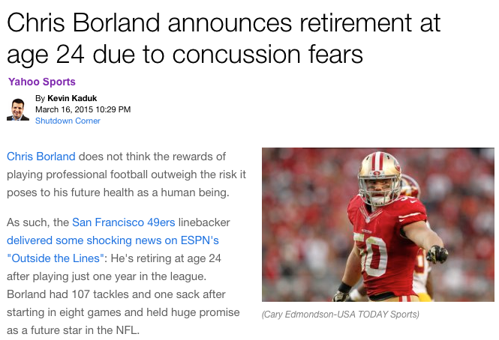
Proprietary & Confidential
24

Slide 25
Chris Borland
Hometown: Kettering, Ohio
Age: 24
High School: Kettering Alter
College: University of Wisconsin
First-team All-America Team – FWAA (2013)
First-team All-Big Ten (2011, 2012, 2013)
Big Ten Defensive Player of the Year (2013)
Big Ten Linebacker of the Year (2013)
NFL Draft: 2014 / 3rd Round / 77th Overall Pick
NFL Career: San Francisco 49ers (2014)
NFC Defensive Player of the Week (Week 11, 2014)
Defensive Rookie of the Month (Nov. 2014)
Retired from NFL in March 2015 due to concerns about the risk of head injuries
Proprietary & Confidential
25

Slide 26
GOAL
Continued focus on the patient through accelerating the development and implementation of improved diagnostics, treatments and cures for PTS and TBI, and related diseases.
Proprietary & Confidential
26

Slide 27
QUESTIONS
onemind.org

